Slide 1
YunTest Framework
Introduction
_{By hongliang.ma}

Slide 2
Agenda
What’s YunTest?
How we work
YunTest Architecture
TestCase Demo

Slide 3
What’s YunTest?

Slide 4
YunTest – New Testing Framework
New test framework
  Execution of end-to-end function testing.
  System testing automation
  Regression testing
Using java language
Based on Spring framework, TestNG, Junit.
Developed by ma hongliang

Slide 5
How we work

Slide 6
SUT
SUT – System Under Test
Target system that should be tested / verified
One or more interfaces / protocols that should be tested

Slide 7
Test Environment
_{Node}
_{(SMS)}
_{Node}
_{(SIP)}
_{Node}
_{(http client)}
_{Parlay X}
_{SIP}
_{HTTP SOAP}
_{SUT}
_{SMPP}
_{HTTP REST}
_{SIP}
_{SMSC)}
_{SIP server}
Web server

Slide 8

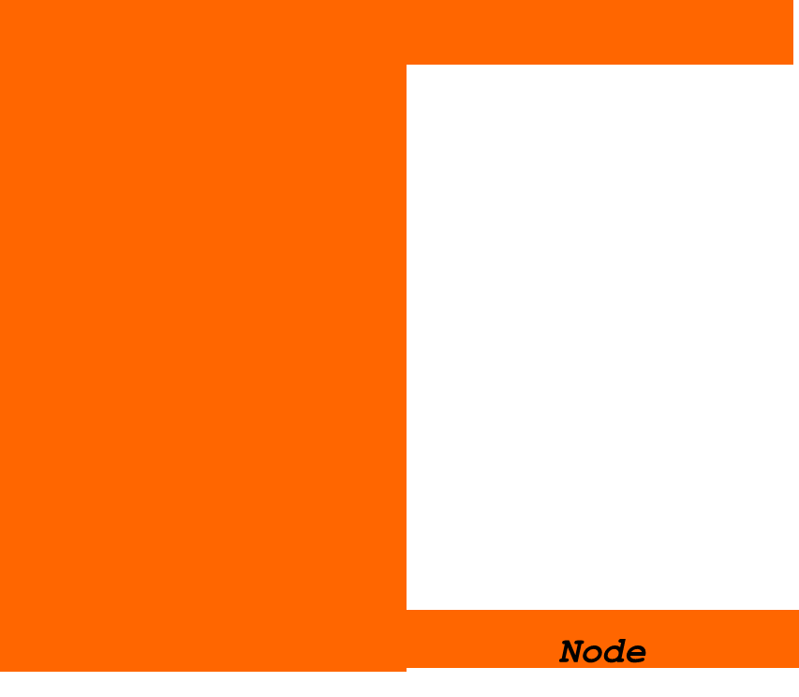
Test Environment
_{Node}
_{SUT}
_{Test environment}

Slide 9
As PN feature in Z7 product
SUT
Client Application
Content Providers
Facebook
1
7
4
6
5
MySpace
SEVEN Client Core Engine
Relay
Server
PN
Server
Host Server
LinkedIn
2
3
Twitter

Slide 10
Test PN Feature in Past
Verification
Verification
SUT
Content Providers
Facebook
MySpace
Devices
or
Look again tools
Relay
Server
PN
Server
Host Server
LinkedIn
Twitter

Slide 11
Test PN Feature Now
You can test it with YunTest like this:
verification
SUT
Yun Test Plugin
For Host server
(verification automatically by test script)
Devices
or
Look again tools
Relay
Server
PN
Server

Slide 12
Test PN Feature Now
Or like this:
SUT
Yun Test Plugin
For Device Client
(verification automatically by test script)
Yun Test Plugin
For Host server
(verification automatically by test script)
Relay
Server
PN
Server

Slide 13
Test PN Feature Now
But I like this, all in one test case :
SUT
Yun Test Plugin
For Device Client
(verification automatically by test script)
Yun Test Plugin
For Host server
(verification automatically by test script)
Relay
Server
PN
Server
YunTest Framework

Slide 14
Test PN Feature Now
You can also do some other check :
SUT
Yun Test Plugin
For Device Client
(verification automatically by test script)
Yun Test Plugin
For Host server
(verification automatically by test script)
Relay
Server
PN
Server
Verify database/ cache/logging/notification/…
YunTest Framework

Slide 15
Test PN Feature Now
With multi-plugins :
SUT
Yun Test Plugin
For Device Client 1
Yun Test Plugin
For Host server 1
Relay
Server
PN
Server
Yun Test Plugin
For Device Client 2
Yun Test Plugin
For Host server 2
Verify database/ cache/logging/notification/…
YunTest Framework

Slide 16
Yun Test Architecture

Slide 17





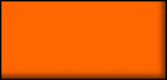

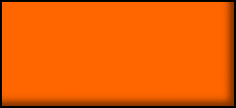





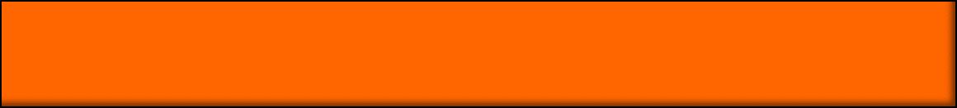
YunTest Architecture
Test Cases
PN1.0 scripts
PN2.0scripts
…
Plug-ins
Z7Client-Plugin
Z7PN1.0-Plugin
Z7PN2.0-Plugin
SMPP-Plugin
…
Common network
UDP/TCP/HTTP/FTP/…
Other Common tools
Database/log/…
Transport & Sync
YunTest
Framework

Slide 18
Plug-in
Handles the communication with SUT
Implements the same interfaces / protocols that the SUT have
Handles the conversion between Yun message classes and the specific protocol / interface

Slide 19
Plug-in
public interface Plugin {
void setIncomingMessageHandler(IncomingMessageHandler handler);
void setTestInteraction(YunTestInteraction testInteraction);
void start();
void send(YunMessage message);
void send(YunMessage message, Object sessionToken);
void execute(YunCommand command);
YunSessionMessage receive();
YunSessionMessage receive(YunMessage message);
void stop();
}

Slide 20
Test Interaction
Defines the “environment” in which the test case executes.
Keeps track of the message flow in test case (send / receive on different plug-ins)

Slide 21
Test Interaction
public interface TestInteraction {
/**
* Set plugin
* @param name
* @return
*/
Plugin getPlugin(final String name);
/**
* Get YunTestManager
* @return YunTestManager
*/
YunTestManager getTestManager();
…...
}

Slide 22
Test Case
The test case, defines the expected message / message flows.
Uses send and receive operations on plug-in interactions.

Slide 23
Test Case
A well defined structure:
  setUp() – Setup part of test case, before execute part
  testStart() – execution test case
  tearDown() – after execution part, clean up afterwards

Slide 24
Test Execution
Test execute
_{Test Interaction}
_{Plug-in}
_{SUT}
_{Send} _{message}
_{Send}
_{Sent OK}
_{Send}
_{Receive}
_{Expect 200 OK}
_{Receive}
_{MAP}
_{Received 200 OK}

Slide 25
Test Case Demo

Slide 26
Thanks

